Slide 1

Leadership Theories

Slide 2
LEADERSHIP
Leadership is one of the four functions of management
Leadership relies on use of position power and personal power
Leadership traits and styles can influence leadership effectiveness
SIX MAIN LEADERSHIP TRAITS and Their characteristics
Transactional and Transformational Leadership & War and Peace Leadership
Foundations For Effective Leadership

Slide 3
Foundations For Effective Leadership
Leadership is one of the four functions of management
Leading – to inspire effort
Communicate the Vision
Build enthusiasm
Motivate commitment and hard work
Planning – to set the directions
Controlling – to ensure results
Management
Process
Organising – to create structures

Slide 4

What is leadership?
Leadership is a transactional process.
A leader affects and is affected by followers
Leadership is transitional. Within a team leadership moves around the team dependent on the stage of the process
Leadership involves influence in a group with a common purpose.
Without influence, leadership does not exist
Leadership involves attaining goals and directing a group of individuals to achieve
Leadership is multi-factorial and distinct from management

Slide 5
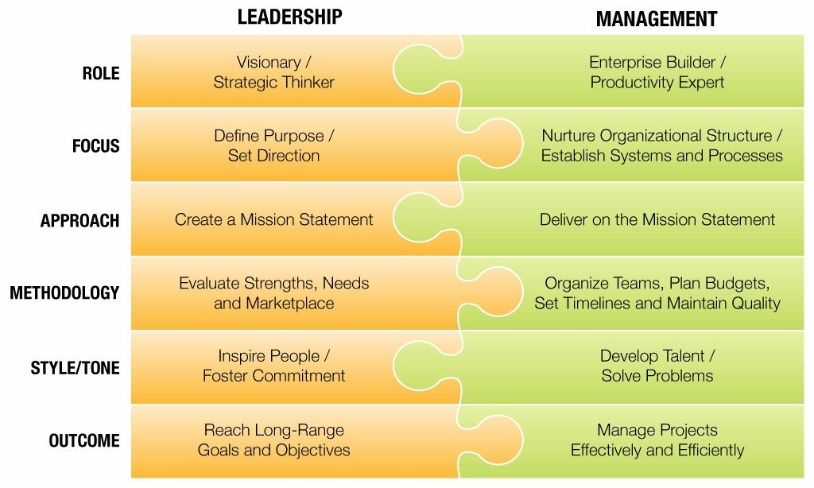
Leadership Vs Management

Slide 6
Foundations For Effective Leadership
Power
the ability to get others to do what you want them to do
Reward Power
The capacity to offer something of value as a means of influencing other people
Coercive Power
The capacity to punish or withhold positive outcomes as a means of influencing other people.
Legitimate Power
The capacity to influence other people by virtue of formal authority or the rights of office.
Expert Power
The capacity to influence other people by virtue of specialized knowledge.
Referent Power
The capacity to influence other people because of their desire to identify personally with you

Slide 7
Foundations For Effective Leadership
Managerial Power = Position Power + Personal Power
Power of the POSITION:
Based on things managers can offer to others.
Rewards: "If you do what I ask, I'll give you a reward."
Coercion: "If you don't do what I ask, I'll punish you."
Legitimacy: "Because I am the boss; you must do as I ask."
Power of the PERSON:
Based on how managers are viewed by others.
Expertise—as a source of special knowledge and
information.
Reference—as a person with whom others like
to identify.

Slide 8
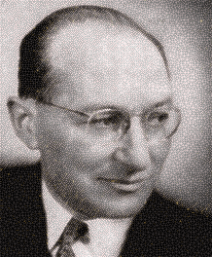
Leadership Style According to
Kurt Lewin
The recurring pattern of behaviors exhibited by a leader
Authoritarian Style
Acts in unilateral command and control fashion
Democratic Style
Encourages participation with an emphasis on both task accomplishments and development of people
Laissez-faire Style
Is low on both tasks and people

Slide 9
Leadership Theories
“Great Man”
Often portray great leaders as heroic, mythic and destined to rise to leadership when needed.
Supports the notion that great leaders are born and not made.
Trait
Assumes that people inherit certain qualities and traits that make them better suited to leadership.
the most common criticisms of trait theory center on the fact that traits are often poor predictors of behaviour.
Behavioural
Based upon the belief that great leaders are made, not born and people can learn to become leaders through teaching and observation.
Participative
suggest that the ideal leadership style is one that takes the input of others into account. However, the leader retains the right to allow the input of others.
Situational
Propose that leaders choose the best course of action based upon situational variables.
Different styles of leadership may be more appropriate for certain types of decision-making.
Contingency
Focus on particular variables related to the environment that might determine which particular style of leadership is best suited for the situation.
According to this theory, no leadership style is best in all situation

Slide 10
“Transactional” theory
This theory of leadership was first described in by sociologist Max Weber, and further explored by Bernard M. Bass in the early 1980s.
Transactional theories, also known as management theories, focus on the role of supervision, organisation and group performance.
These theories base leadership on a system of rewards and punishments.
Managerial theories are often used in business; when employees are successful, they are rewarded; when they fail, they are reprimanded or punished.

Slide 11
Basic Assumptions of Transactional Leadership
People perform their best when the chain of command is definite and clear.
Workers are motivated by rewards and punishments.
Obeying the instructions and commands of the leader is the primary goal of the followers.
Subordinates need to be carefully monitored to ensure that expectations are met.

Slide 12
“Transformational” theory
Relationship theories, also known as transformational theories, focus upon the connections formed between leaders and followers.
Transformational leaders motivate and inspire people by helping group members see the importance and higher good of the task.
These leaders are focused on the performance of group members, but also want each person to fulfill his or her potential.
Leaders with this style often have high ethical and moral standards.

Slide 13
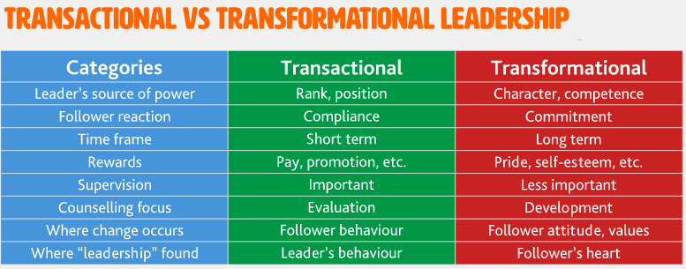

Slide 14
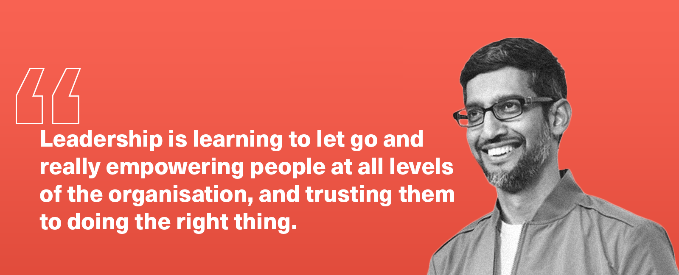
LEADERSHIP Trends In Leadership Development
Moral Leadership
Builds trust from a foundation of personal integrity
Ethical Leadership
Has integrity and appears to others as “good” and “right” by moral standards
Integrity
In leadership is honesty, credibility and consistency in putting values into action
Servant Leadership
Means serving others, helping them use their talents to help organizations best serve society
Empowerment
Gives employees job freedom and power to influence affairs in the organization

Slide 15
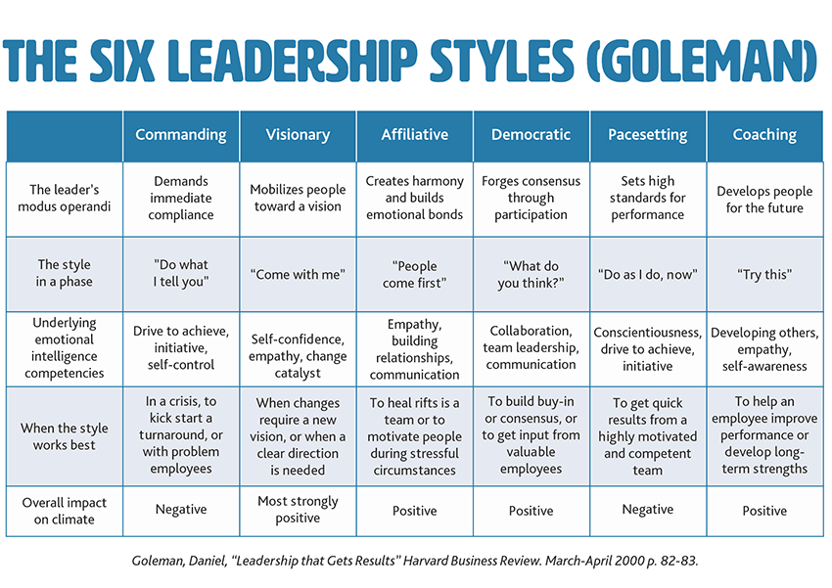

Slide 16
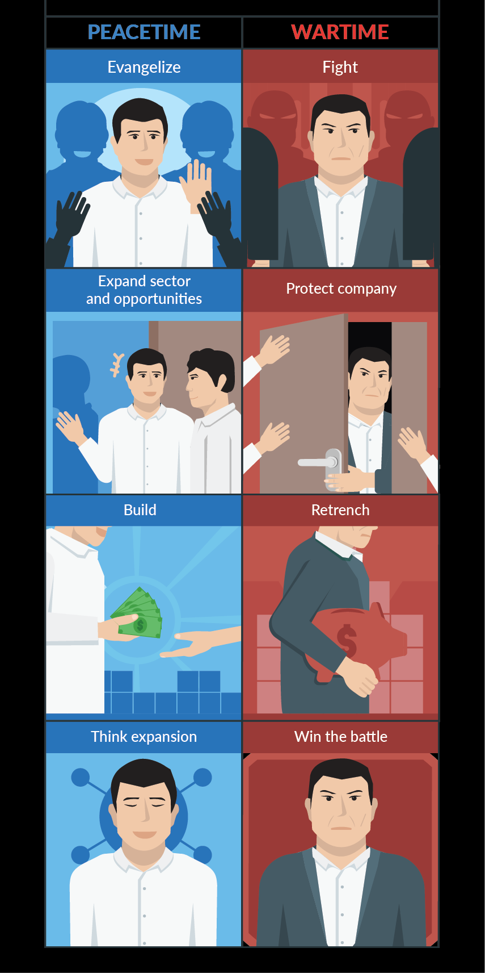
Foundations For Effective Leadership (Horowitz)

Slide 17

Question Time

